Slide 1
The 5 photo rules
Thanks for riley for giving me ideas for some of the photos

Slide 2
1. Avoid merges

Slide 3
Avoid mergers
I Think this is a great photo to represent avoid mergers
First, it has a simple background
Second, I changed the view by moving left
Third, the background is not detracting people from looking at the frog

Slide 4
2. Lines

Slide 5
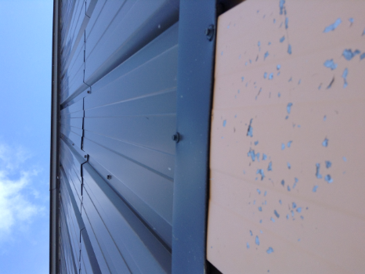
l think this is the line rule because
The lines lead the viewers to the center
2. I kept my photo simple
3. Used geometric shapes

Slide 6
3. Rules of thirds =3

Slide 7
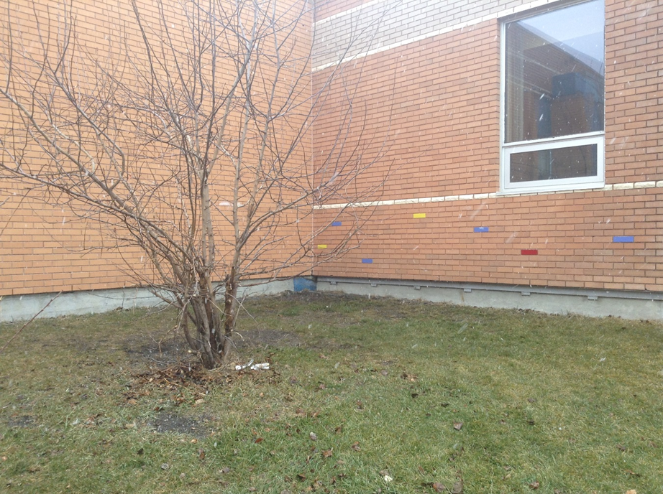
Rules of thirds
I think this follow the rule of thirds
Because the tree is not in the middle but
Close to the middle and i kept it simple

Slide 8
4. Simply

Slide 9
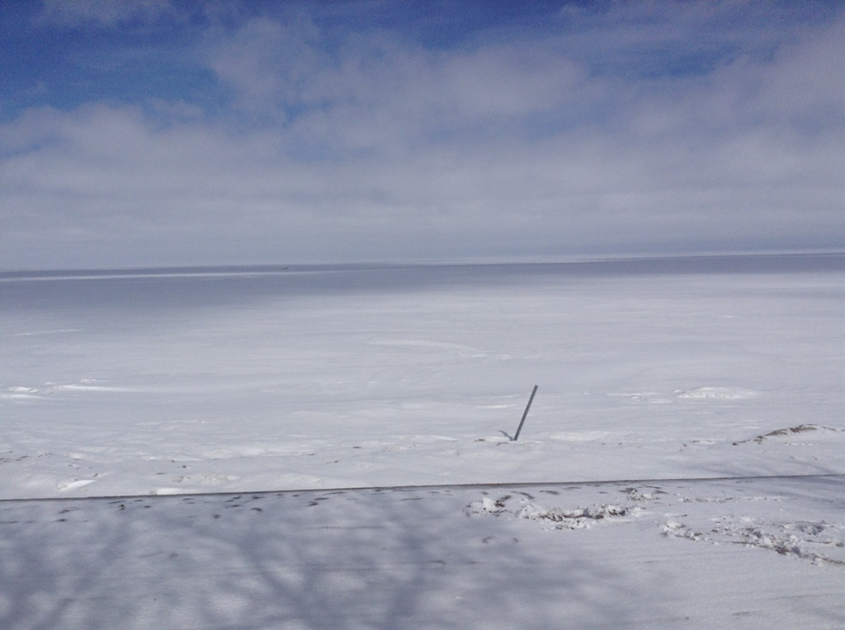
Simply
I think I followed the rule of simply
Because I kept the photo simple and nice

Slide 10
5. Framing dat face doe

Slide 11
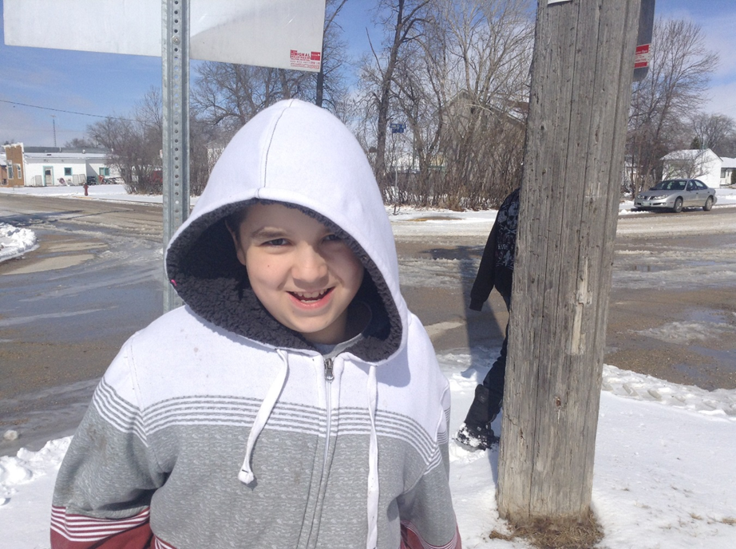
framing
I think this follows the framing rule pretty
Good but the frame is a little off and
Simple but I think this is a pretty good for
framing

Slide 12
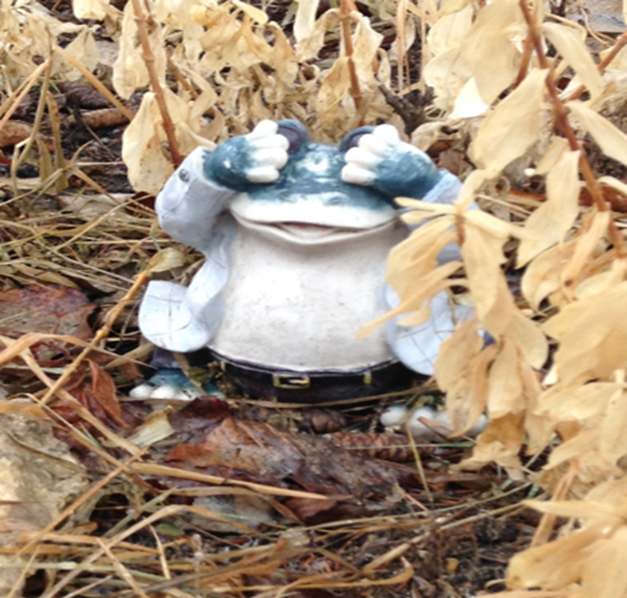
And my favorite is
This frog favorite it’s a really good photo I think

