Slide 1
Lakelyn’s Composition
Photo’s
By Lakelyn Ilienko

Slide 2
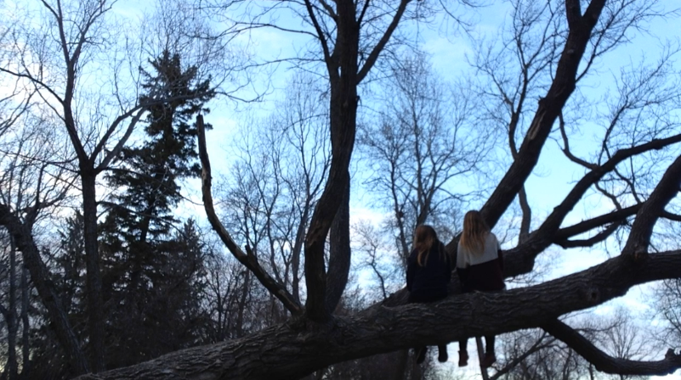
Rule of lines
Because it’s a very simple picture so it makes the lines show out more in it. With all the trees the kind of make a effect of lines. It adds for interest with all the lines in like every place you can basically find in this picture. That’s why it follows the rule of lines.

Slide 3
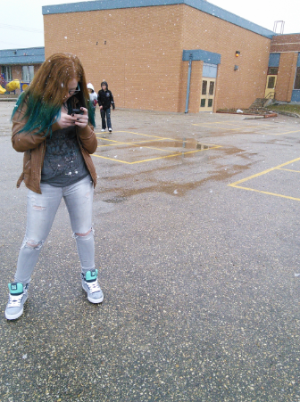
Rule of thirds
This is the rule of thirds because of the spaceing. Because you spilt it in thirds from tops to bottoms in thirds you would see montana is in the left rectangle.

Slide 4
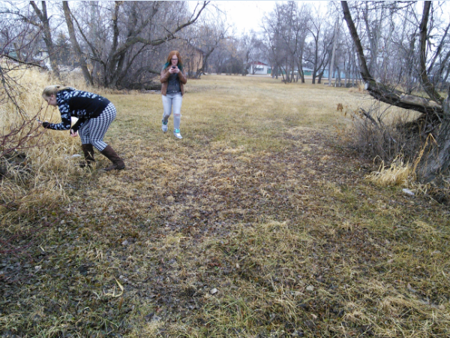
Framing
Its framing because the trees and grass is framing around Montana and Calista. And its obvious to tell what the most important things in the picture are.

Slide 5
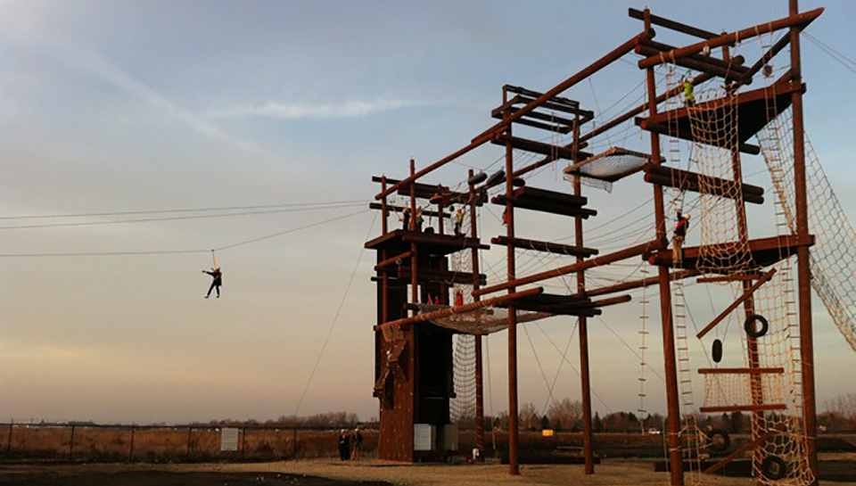
Rule of avoid merges
  Because the background is very simple in this picture. Its plain and the colors of the back is pretty to but you can stay focused on the actual thing.

Slide 6
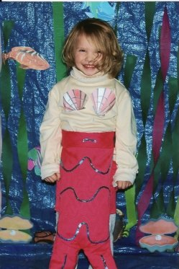
Cropping
I chose this one for cropping because It was cropped quite from the photo. And you can that it was cropped because there was only one thing on center scenteer of the photo.

Slide 7

Fav photo
Because follows the rule of thirds. Alos the rule simplicity. And the framing effect on it too that’s why I kicked this phot because its cool and follows a lot of rules.

