Slide 1
Hello

Slide 2
Today I am presenting
About a famous
person

Slide 3
Elon Musk

Slide 4
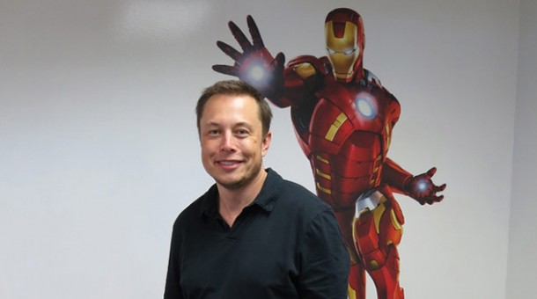
Elon Musk

Slide 5
Elon Musk
The REAL Tony Stark?

Slide 6
I mean who is Tony Stark in the comics?

Slide 7
I mean who is Tony Stark in the comics?

Slide 8
I mean who is Tony Stark in the comics?
Tony is super smart

Slide 9
I mean who is Tony Stark in the comics?
Tony is super smart
Super charming

Slide 10
I mean who is Tony Stark in the comics?
Tony is super smart
Super charming
A very smart business man

Slide 11
I mean who is Tony Stark in the comics?
Tony is super smart
Super charming
A very smart business man
Invents technology that changes the world

Slide 12
I mean who is Tony Stark in the comics?
Tony is super smart
Super charming
A very smart business man
Invents technology that changes the world
Allows the whole world to benefit by using his technologies

Slide 13
I mean who is Tony Stark in the comics?
Tony is super smart
Super charming
A very smart business man
Invents technology that changes the world
Allows the whole world to benefit by using his technologies
And is a self-made billionaire!

Slide 14
I mean who is Tony Stark in the comics?
Tony is super smart
Super charming
A very smart business man
Invents technology that changes the world
Allows the whole world to benefit by using his technologies
And is a self-made billionaire! (…several times over)

Slide 15
Who is Elon Musk in real life?

Slide 16
Who is Elon Musk in real life?
Elon Musk is super smart

Slide 17
Who is Elon Musk in real life?
Elon Musk is super smart
Super charming

Slide 18
Who is Elon Musk in real life?
Elon Musk is super smart
Super charming
A very smart business man

Slide 19
Who is Elon Musk in real life?
Elon Musk is super smart
Super charming
A very smart business man
Invents technology that changes the world

Slide 20
Who is Elon Musk in real life?
Elon Musk is super smart
Super charming
A very smart business man
Invents technology that changes the world
Allows the whole world to benefit by using his technologies

Slide 21
Who is Elon Musk in real life?
Elon Musk is super smart
Super charming
A very smart business man
Invents technology that changes the world
Allows the whole world to benefit by using his technologies
And is a self-made billionaire!

Slide 22
Who is Elon Musk in real life?
Elon Musk is super smart
Super charming
A very smart business man
Invents technology that changes the world
Allows the whole world to benefit by using his technologies
And is a self-made billionaire! (…also several times over)

Slide 23
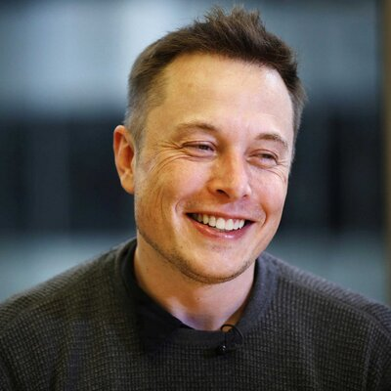
What is he best known for?
Creating Motor-X (paypal)

Slide 24
What is he best known for?
Creating Motor-X (paypal)
Tesla motors

Slide 25
What is he best known for?
Creating Motor-X (paypal)
Tesla motors
Designing the hypertube

Slide 26
What is he best known for?
Creating Motor-X (paypal)
Tesla motors
Designing the hypertube
Space-X

Slide 27
Biography

Slide 28
Quick Facts
Born in South Africa

Slide 29
Quick Facts
Born in South Africa
Had an early startup company he sold to Compaq for millions

Slide 30
Quick Facts
Born in South Africa
Had an early startup company he sold to Compaq for millions (…in his early twenties)

Slide 31
Quick Facts
Born in South Africa
Had an early startup company he sold to Compaq for millions (…in his early twenties)
In 2000 he made paypal

Slide 32
Quick Facts
Born in South Africa
Had an early startup company he sold to Compaq for millions (…in his early twenties)
In 2000 he made paypal (…and sold that for many millions)

Slide 33
Quick Facts
Born in South Africa
Had an early startup company he sold to Compaq for millions (…in his early twenties)
In 2000 he made paypal (…and sold that for many millions)
In 2002 he made Space-X

Slide 34
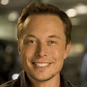
Early Life
First computer at age 10
Taught himself to program by age 12
Sold his first software that year (…a game called “Blaster”)
When to U.S. University (Queen’s and Pennsylvania) at age 17 to study many things including business.

Slide 35
Young Adult Life
THEN he went to Stanford University to get a PhD in Physics…but he dropped out to create the Zip2 Corporation (…his first company/corporation)
Later sold this to Compaq for $341,000,000

Slide 36
Young Adult Life
Then he create xcom which became paypal (…which he sold to ebay for $1,200,000,000)
Then he designed rockets and created Space-x which has made MANY deals with NASA, created the first commercial space flights, and is now the main spaceship builder for the western world.

Slide 37
Mid-years to today
Another Musk venture is Tesla Motors, an automobile company dedicated to producing affordable, mass-market electric cars, which he co-founded in 2003. With a stake in the company taken by Daimler and a strategic partnership with Toyota, Tesla Motors launched its initial public offering in June 2010, raising $226 million.

Slide 38
More cool stuff about him…
He wants to populate Mars
He created the Musk Foundation which is dedicated to human space exploration for the good of humanity and for finding clean energy sources.

Slide 39
More cool stuff about him…
In August 2013, he released a concept for a new form of transportation called the "Hyperloop." The new invention is intended travel at speeds greater than 700 miles per hour to commute between major cities while severely cutting the time of travel. As opposed to using railroads, the Hyperloop would use tubes for transportation, creating travel options between Los Angeles and San Francisco—the original proposed location—that would take a shorter amount of time than a flight. Musk says that the Hyperloop could take from seven to 10 years to be built and ready for use.

Slide 40
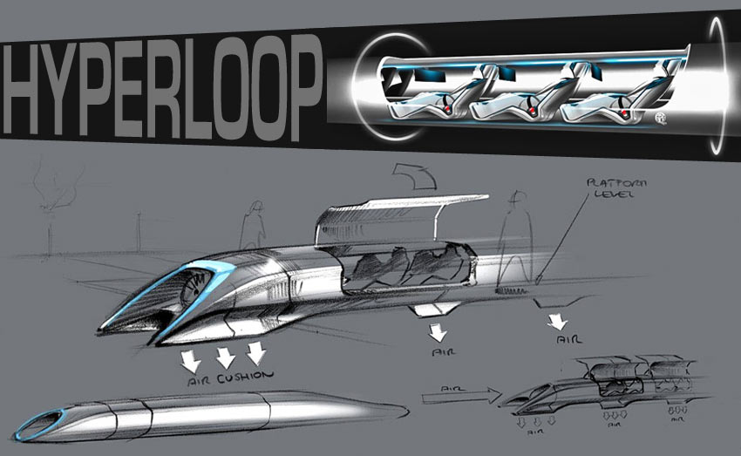
More cool stuff about him…
In August 2013, he released a concept for a new form of transportation called the "Hyperloop." The new invention is intended travel at speeds greater than 700 miles per hour to commute between major cities while severely cutting the time of travel. As opposed to using railroads, the Hyperloop would use tubes for transportation, creating travel options between Los Angeles and San Francisco—the original proposed location—that would take a shorter amount of time than a flight. Musk says that the Hyperloop could take from seven to 10 years to be built and ready for use.

Slide 41
More cool stuff about him…
In August 2013, he released a concept for a new form of transportation called the "Hyperloop." The new invention is intended travel at speeds greater than 700 miles per hour to commute between major cities while severely cutting the time of travel. As opposed to using railroads, the Hyperloop would use tubes for transportation, creating travel options between Los Angeles and San Francisco—the original proposed location—that would take a shorter amount of time than a flight. Musk says that the Hyperloop could take from seven to 10 years to be built and ready for use.
…and it was given to humanity
For free!

Slide 42
More cool stuff about him…
Elon Musk not only has made more than $1,000,000,000,000 in his life just by being extremely smart…about everything, but he also GIVES OVER HALF OF ALL HIS MONEY TO CHARITY!!!

Slide 43
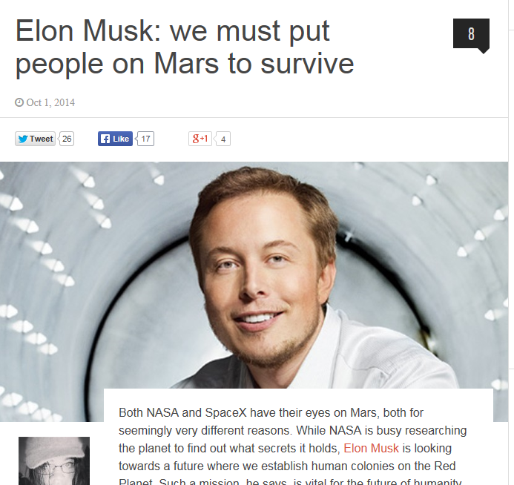
I mean who is Tony Stark in the comics?

Slide 44
Elon Musk

Slide 45
Sources
http://www.biography.com/people/elon-musk-20837159#hyperloop
http://blogs.nwmissouri.edu/ISNews/2013/10/04/hyperloop-the-fifth-mode-of-transportation/
http://openitagency.eu/tesla-motors/
https://twitter.com/elonmusk

