Slide 1
TOP TEN BEST!!!!!!
VIDEO GAMES

Slide 2
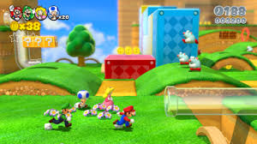
10. SUPER MARIO 3D world
Mario is one of my favorite games because its like an opstacle course and you can get power ups like a fire flower or star power. Because this is 10 is because I rage at Mario and I suck at the game!!!

Slide 3
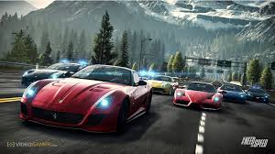
9. NEED FOR SPEED
Need for speed is fun and I always win on it but when my dad plays he always wins so this is why its 9 and if u guys like racing then I suggest u play this game cause its so fun and why its fun because u can go on ramps and u can go and go off cliffs

Slide 4
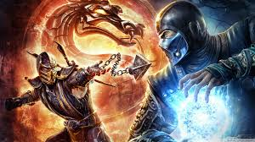
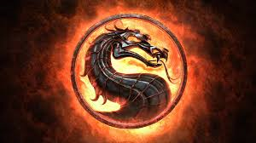
8. MORTAL KOMBAT
I have to say mortal kombat is one of my favorite fighting games of all time because the characters have powers…….that was weird but anyways this is my favorite game and I suggest you play it if you like this kind of stuff then yeah

Slide 5
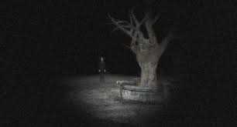
7. SLENDER RISING
Slender rising can be fun but it scares me like crazy but if you’re a horror game fan I know you will like slender rising. The point to the game is you have to find 8 pages in a forest and make sure not to look at slenderman

Slide 6
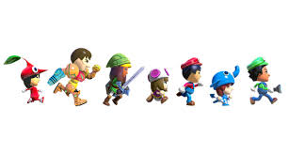
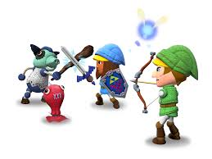
6. Nintendo land
I love Nintendo land because you can play mini games like the legend of Zelda, Metroid and Mario and its lots of fun and I hope you like it cause I love it because you can be different characters and you can explore around

Slide 7
5. Gta 5
I like gta 5 because you can go around the city and jump of buildings and crash your car. Its so fun and I hope you guys try it out because its funny to die in the game

Slide 8
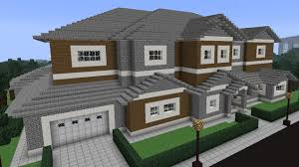
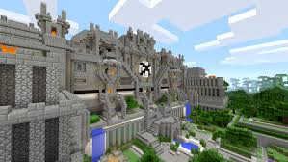
4. minecraft
Minecraft is fun because you can build anything up to a house to a giant awesome castle and theres so much to do in minecraft like build, fight, explore and play mini games on servers

Slide 9
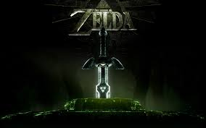
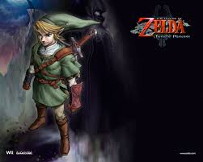
3. The legend of zelda
This is a really fun game because you can explore and its an open world game so you can go where every you want and you get a sword and a shield and your job is to fight creatures and save the princess

Slide 10
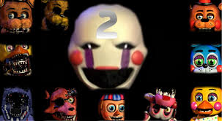
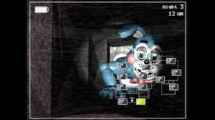
2. Five nights at freddy’s 2
I love this game because your challenge is to survive 5 nights and your gonna die and be prepared to get scared because its scary but once you get used to it its not scary anymore but its really fun and you should play it

Slide 11
MY FAVORITE GAME OF ALL TIME IS………

Slide 12
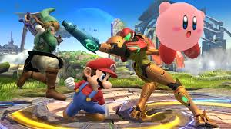
1. SUPER SMASH BROS 4
This game is a mixture of Mario, sonic, pacman, megaman, the legend of Zelda and pokemon. Its so fun cause you have to battle a bunch of video game characters created by Nintendo, Capcom and saga and its just so awesome so I suggest you play it!!!!!!!!!!!!!!

Slide 13
Thank you for listening to my presentation

